Slide 1
College Degree Levels
Part 1
College Prep
Mr. Gordon
jgordon@bisdtx.org

Slide 2
Upcoming Events
Tues. Sept. 28th Spring Break 2023 Belize Travel Informational Meeting
Fri. Oct. 8th No School
Mon. Oct. 11th BISD Holiday, but 11th graders still have ACC
Thurs. Oct. 14th 6PM CRCA in BISD Homecoming Parade
Sat. Oct. 16th 8AM-2PM 11th Grade PSAT
hi

Slide 3
College Degree Levels
College degrees are divided into four categories:
Associate Degree
Bachelor’s Degree
Master’s Degree
Doctoral Degree
You will hear these terms used often at CRCA when discussing College and Career.
hi

Slide 4
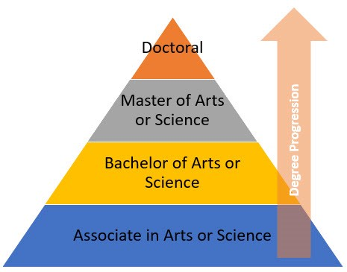
College Degree Levels
hi

Slide 5
Associate Degree
This is the degree you are currently working towards while at ACC.
If you follow the common pathway at CRCA, you will graduate with both a high school diploma and an Associate of Arts in General Studies diploma from Austin Community College.
(You may remember from a past College Prep that there are other Associate degrees you can obtain, but this is the most common.)
hi

Slide 6
Associate Degree
Usually takes two years to complete.
Must complete 60 credit hours from a community college.
Link for AA General Studies Degree Plan
https://www6.austincc.edu/cms/site/www/awardplans/awardplan.php?year=2022&type=CC&group=%400004&apid=6815
hi

Slide 7
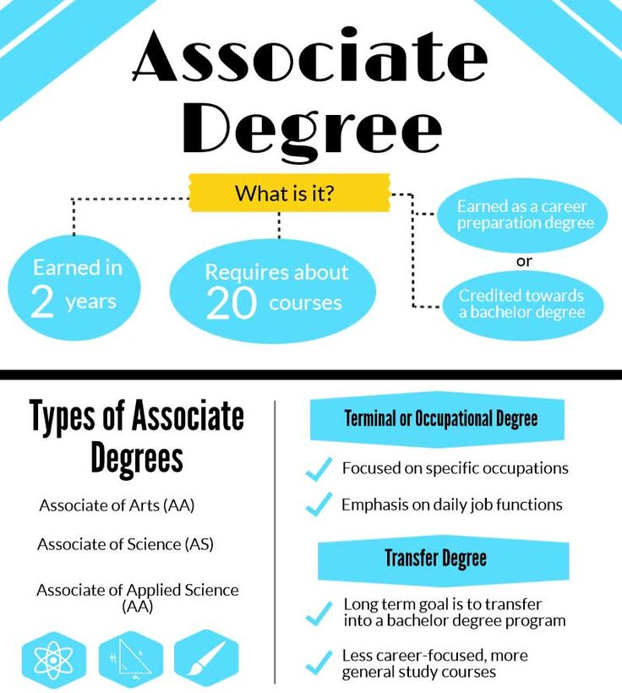
Arrows are the track you are currently on.
Associate Degree
hi

Slide 8

Bachelor’s Degree
A Bachelor’s degree comes after an Associate degree.
Usually takes four years to complete.
Must complete 120 credit hours from a public or private university.
(only 60 hours if you earn your Associate degree first)
hi

Slide 9
Bachelor’s Degree
First two years generally involve general education classes
ie. English, History, Government
And introductory classes for a student’s major.
During the next two years, students take advanced classes in their major.
Depending on the career, a Bachelor’s degree may be all that you need.
hi

Slide 10
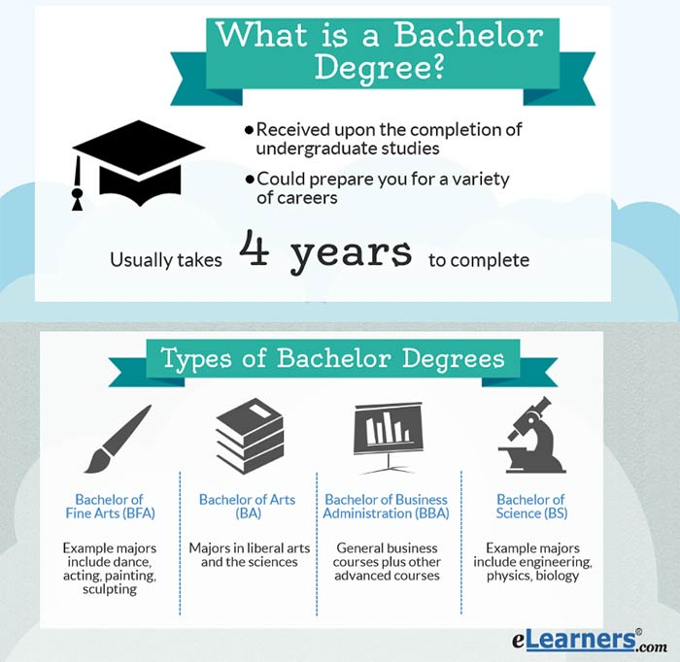
hi

Slide 11
Today’s College Prep Assignment
In the comments section of today’s College Prep,
answer the following question:
How many college credit hours will you have
by the time you graduate from CRCA?
hi

